Slide 1
Basic Encodings and Embeddings
Tsungwei

Slide 2
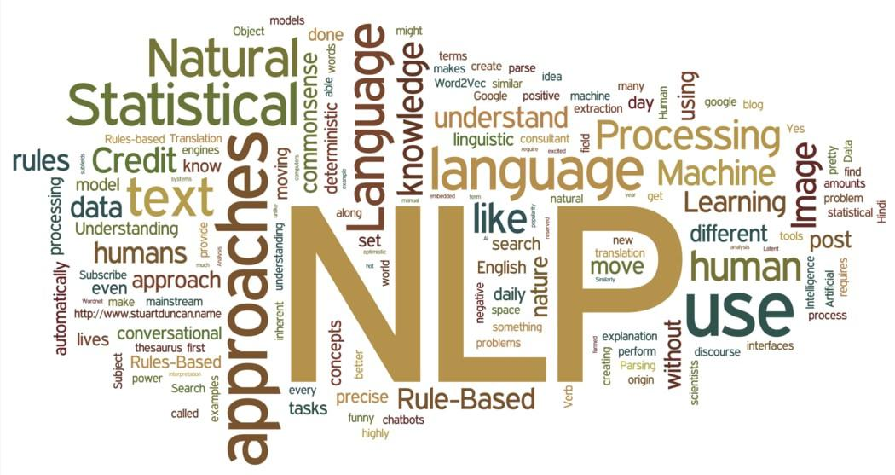
For recently papers in NLP,
They all suggest us to do the task with pre-training weight!!

Slide 3
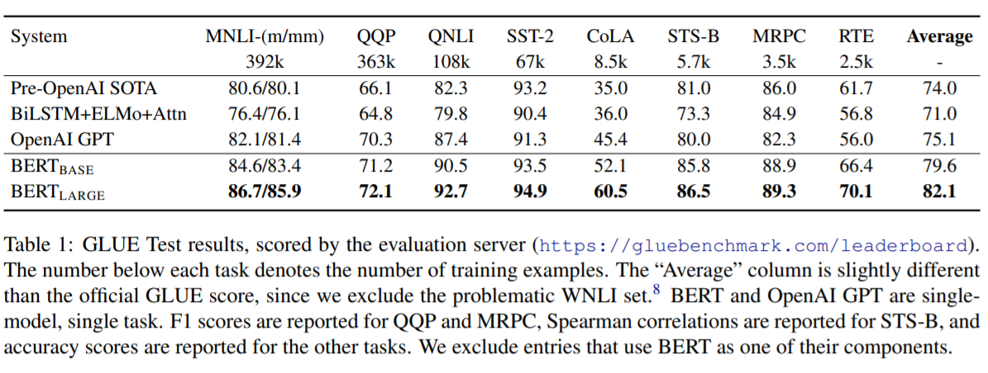
BERT-2018 by Google
In 2018, Google released BERT.
They tell us how powerful is pre-training.
Notes:
(General Language Understanding Evaluation) 9 task in it.

Slide 4

Google PaPa is rich
Notes:
So far, we can know that Pre-training is very powerful.
But, is it possible we can try it on our own?
Actually...It’s very hard to do that.
The power of Pre-training is based on HUGE data and resource.
But, we can use it for free, thanks to those who released their weights for free on Internet.

Slide 5
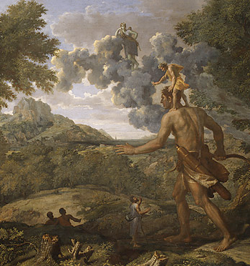
Why So Powerful...?
Notes:
We can image that pre-training just like someone want to learn new language, and this guy already has concept of “what language is”, So this guy will learn it fast.
Without pre-training, your model will be like a baby, learn from scratch, it didn’t know what is grammar, what is words, so it will be slow, it will be low efficient.

Slide 6
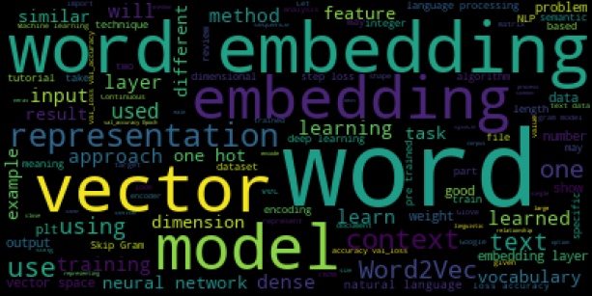
Pre-training is What? I
When we want to let machine to learn our human language, we can’t just give machine the string. It won’t take it.
We need to convert the string into digit.
Machine only can read and calculate digit.
So we need to do something call Embedding.

Slide 7
Pre-training is What? II
Let’s talk about Embedding.
When we are using Pre-training weight, actually we want to get a good Embedding from those Pre-training weight.
We can say that if we can have good embedding, we can solve most of the NLP tasks.

Slide 8
Why Embedding SO important?
We’ve talked about converting string into digits.
But more clear to say , we are converting strings into vectors.
Notes:
So how to represent a word in vector space would be very important.
A good vector to represent the word should include many information.
Such like, grammar, position, meaning of the word...etc.
This process we will call it Embeddings.
If we have good Embeddings for words, we will have enough information for any NLP tasks.

Slide 9
Ways of Embedding
In NLP module, we will see a component call “Language Model”.
What is it?
Notes:
Actually it’s a model to predict next word.(One of the way to use it.)
But in current stage we can use it for Embeddings.
For example:” I like...” next word could be “you” or “dog”.
It’s a probability problem.
Here , we can say the model can understand grammar, semantic information.
Also, we still have another way to do Embeddings, such like One-Hot encoding, TF-IDF...etc.

Slide 10
Ways of Embedding
So what’s the difference between using LM and classical way(ex:TF-IDF)?
LM:
It can have semantic information for Embeddings.
Unsupervised model, need larger dataset to train.
Time cost higher.
It can use pre-training weight.
Classical way:
Unsupervised model, no need larger dataset to train.
Time cost less.
It can be good on particular scenario.
Based on word-frequency no semantic information.

Slide 11
Ways of Embedding
Let’s go deeper of those Embedding way!!!
One-hot encoding
TF-IDF(term frequency–inverse document frequency)
N-gram
Word2Vec
GloVe(Global Vectors for Word Representation)

Slide 12
Ways of Embedding
One-hot encoding
TF-IDF
N-gram
Word2Vec
GloVe

Slide 13
Ways of Embedding - One-hot Encoding
It’s a very simple way to do the embeddings.
We split the sentence into words.
Build a dictionary with those words.
And we represent the words in “Binary”.

Slide 14
Ways of Embedding - One-hot Encoding
For example:
sentence=[“I like dogs.”]
Split it.
words=[‘I’, ‘like’, ‘dogs.’]
dictionary={‘I’:1, ‘like’:2, ‘dogs.’:3}
Binary represent:
[100,010,001]

Slide 15
Hands-on!!

Slide 16
Ways of Embedding - One-hot Encoding
So… after trying, what are the advantages of this way?
And what are the disadvantages of this way..?

Slide 17
Ways of Embedding - One-hot Encoding
Advantage:
Easy to understand
Fast implementation
Disadvantage:
Every word is of equal importance.
Lack of semantic information.
Curse of dimensionality. The vector is sparse.

Slide 18
Ways of Embedding
One-hot encoding
TF-IDF
N-gram
Word2Vec
GloVe

Slide 19
Ways of Embedding - TF-IDF
In one-hot encoding, we know that the words shouldn’t be of same importance.
So how can we re-weight the words?

Slide 20
Ways of Embedding - TF-IDF
We can see the frequency of each word in sentences.
If this word is higher frequency in this sentence, rare to see it in other sentence, it mean that this word is important to this sentence.
This is the simple idea of TF-IDF.

Slide 21

Ways of Embedding - TF-IDF
TF-IDF(term frequency-inverse document frequency)
In TF-IDF algorithm, we can break it into two parts.
One is TF, another one is IDF.
Notes:
TF:Calculation a word’s frequency in a sentence or a document.
If frequency of this word is high in a sentence or a document,
which means this word can be more stand for this sentence or this document.
IDF:Calculation a word’s frequency in “sentences” or “documents”.
If frequency of this word is low in sentences or documents,
which means this word can represent a particular sentence or
document.

Slide 22
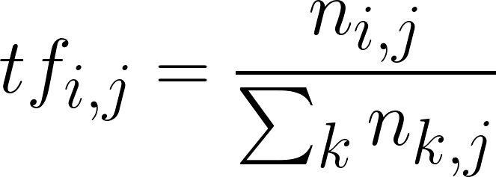
Ways of Embedding - TF-IDF
TF Formula:
Example: document J all words frequency is 100, and “cow” in J has appeared 3 times. TF(cow)=0.03
Notes:
ni,j is the word ti’s frequency in document j, nk,j is all word‘s frequency sum in document j.

Slide 23
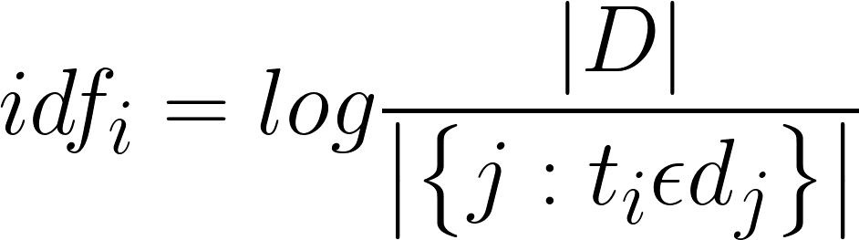
Ways of Embedding - TF-IDF
IDF Formula:
Notes:
|D| is your total documents.
|{j:ti ∈ dj}| is how many documents including ti.
Usually, we will use 1+|{j:ti ∈ dj}| , in case, ti is not in any documents.
Divisor can’t be 0.

Slide 24
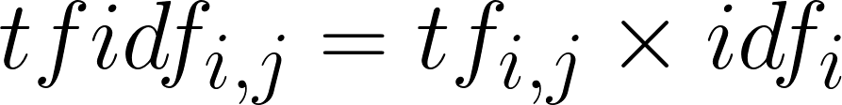
Ways of Embedding - TF-IDF
TF-IDF Formula:
Notes:
A high frequency word in a particular document, and this word is rare in other documents , the TF-IDF weight of this word will be very high!

Slide 25
Ways of Embedding - TF-IDF
Now we know how TF-IDF give the weight to words.
But according to the algorithm, is there something strange...?

Slide 26
Ways of Embedding - TF-IDF
When we using TF-IDF as the way to do Embeddings, we need to filter the stopwords first.
Stopwords has no meaning, and it will make the TF-IDF not reliable.
We just want to focus on meaningful word, and give them weights.

Slide 27
Hands-on!!

Slide 28
Ways of Embedding - TF-IDF
So… after trying, what is the advantage of this way?
And what is the disadvantage of this way..?

Slide 29
Ways of Embedding - TF-IDF
Advantage:
1.We re-weight the words.
2.The idea is easy to explain.
3.Still can do it fast.
Disadvantage:
1.Dimension is huge. The vector is sparse.
2.The weight is based on frequency, no semantic information.
3.Stopwords(No meaningful words) will affect the result.

Slide 30
Ways of Embedding
One-hot encoding
TF-IDF
N-gram
Word2Vec
GloVe

Slide 31
Ways of Embedding - N-gram
In One-Hot encoding and TF-IDF, we mentioned that no semantic information in it.
So why semantic information is important?

Slide 32
Ways of Embedding - N-gram
In human language, we have a lot of synonyms.
If we just calculate the word frequency, we will make synonyms into different word.
So semantic information is important.
Let’s see how to get the semantic information.

Slide 33

Ways of Embedding - N-gram
N-gram is using N words as input to predict next word.
It will become a probability question.
So it’s formula would be very simple:
it will look like this:
Notes:
d is the words, the (1),(2)... are the position in sentence.
eol is end of line.

Slide 34
Ways of Embedding - N-gram
Example: we calculate some documents, we have information like this:
{i:780, want:253, to:325, eat:175, some:95, foods:105 }
So let’s make it into probability.
 | i | want | to | eat | some | foods
i | 7 | 150 | 0 | 7 | 0 | 2
want | 5 | 0 | 200 | 2 | 4 | 1
to | 0 | 0 | 0 | 130 | 1 | 5
eat | 5 | 0 | 7 | 0 | 70 | 30
some | 2 | 0 | 1 | 5 | 0 | 80
foods | 1 | 0 | 1 | 0 | 2 | 0

Slide 35
Ways of Embedding - N-gram
Example: we calculate some documents, we have information like this:
{i:780, want:253, to:325, eat:175, some:95, foods:105 }
 | i | want | to | eat | some | foods
i | 0.009 | 0.592 | 0 | 0.04 | 0 | 0.019
want | 0.006 | 0 | 0.615 | 0.011 | 0.042 | 0.01
to | 0 | 0 | 0 | 0.742 | 0.011 | 0.047
eat | 0.006 | 0 | 0.021 | 0 | 0.736 | 0.286
some | 0.003 | 0 | 0.003 | 0.028 | 0 | 0.761
foods | 0.001 | 0 | 0.003 | 0 | 0.021 | 0

Slide 36
Ways of Embedding - N-gram
Training data example:
sentence=”i like dogs and cats”
Window-size=2(Bi-gram),(input, label)
i like dogs and cats⇒ (“i”,”like”)
i like dogs and cats⇒ (“like”,dogs)
i like dogs and cats⇒ (“dogs”,”and”)
i like dogs and cats⇒ (“and”,”cats”)
I like
like dogs
dogs and
and cats

Slide 37

Ways of Embedding - N-gram
So according to the example(Bi-gram), we know when we input a word, we will have the next word probability.
Where is the semantic information…?

Slide 38
Ways of Embedding - N-gram
As you can see when we input “want”, the highest word is “to”.
What’s this?
This is grammar.
And here is our semantic information.

Slide 39
Ways of Embedding - N-gram
Until now, we know something about N-gram.
But there is a problem in it…. What is it?

Slide 40
Ways of Embedding - N-gram
Let’s break down the algorithm of N-gram.
(Bi-gram)
First step:
We calculate the words frequency in documents.
Second step:
We split the a document into 2-words set.
[“I like cat and dog.”] ⇒ [“I like”,”like cat”, “cat and”, “and dog.”]
Third step:
We calculate the frequency of 2-words set.
Fourth step:
We calculate the probability.

Slide 41
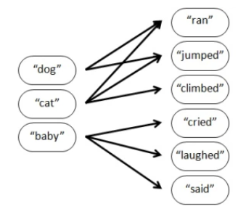
Ways of Embedding - N-gram
So except the vocabulary frequency dictionary.
We will have another dictionary⇒ 2-words set.
So let’s visual the 2-word set.
Notes:
We have “dog ran”, “dog jumped”,
But we don’t have “dog climbed”.
This is the problem.

Slide 42
Ways of Embedding - N-gram
N-gram algorithm depends on the N-word set to calculate the probability for words.
So if not in the N-word set, it can’t give the probability.

Slide 43
Hands-on!!

Slide 44
Ways of Embedding - N-gram
So… after trying, what is the advantage of this way?
And what is the disadvantage of this way..?

Slide 45
Ways of Embedding - N-gram
Advantage:
1.We re-weight the words, and the weights including the semantic information.
2.The idea is easy to explain.
3.Unsupervised training.
4.We can control the dimension.
Disadvantage:
1.Depends on vocabulary size, easy to OOV(out of vocabulary).
2.Training take time.
3.The semantic information only from previous N words.

Slide 46
Ways of Embedding
One-hot encoding
TF-IDF
N-gram
Word2Vec
GloVe

Slide 47
Ways of Embedding - Word2Vec
N-gram?
example:“I love you, as a friend” and “I love you”
Word2Vec!!!
Notes:
But N-gram only using the previous N words to predict next word.
Sometimes, the word might be affected by next few words.
example:“I love you, as a friend” and “I love you”
I believe the “love” in this two sentences are totally different meaning….
So in W2V, we will use the words around the word to predict it.
We call it CBOW(Continuous Bag-of Words).

Slide 48
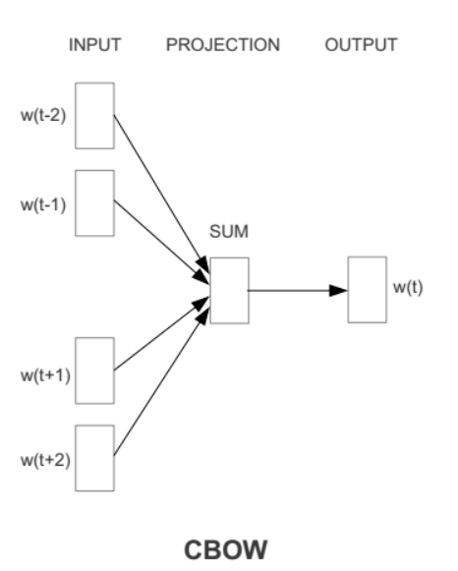
Ways of Embedding - Word2Vec(CBOW)
As we have mentioned, CBOW(Continuous Bag of Words) is using the around-words to predict current word.
So basically, the idea is not far from N-gram, just including “next” N words.

Slide 49
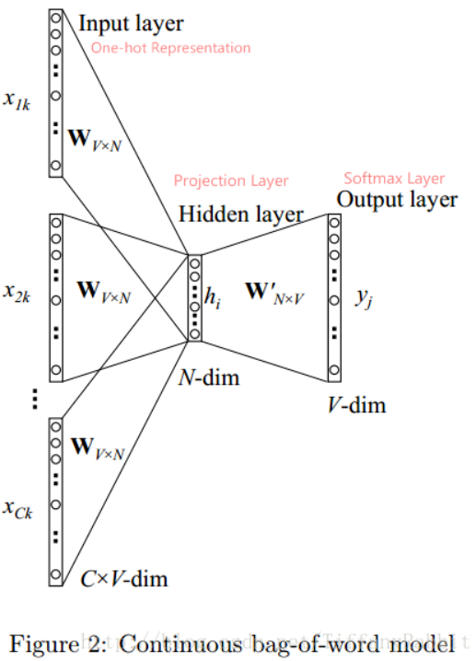
Ways of Embedding - Word2Vec(CBOW)
Let’s see the structure.
Notes:
Definition:
D documents, V is vocabulary numbers
C is window size
X1k...XCk would be one-hot encoding of words.
X1k...XCk dimension would be V.
Hidden layer is N-dim.
No activation function in hidden layer

Slide 50
Ways of Embedding - Word2Vec(CBOW)
Training data example:
sentence=”i like dogs and cats”
Window-size=2(left and right),(input, label)
“i like dogs” and cats⇒ (”like, dogs” ,“i”)
“i like dogs and” cats⇒ (“i, dogs, and” ,”like”)
“i like dogs and cats”⇒ (“i, like, and, cats” ,”dogs”)
i “like dogs and cats”⇒ (“like, dogs, cats” ,”and”)
i like “dogs and cats”⇒ (“dogs, and” ,”cats”)

Slide 51
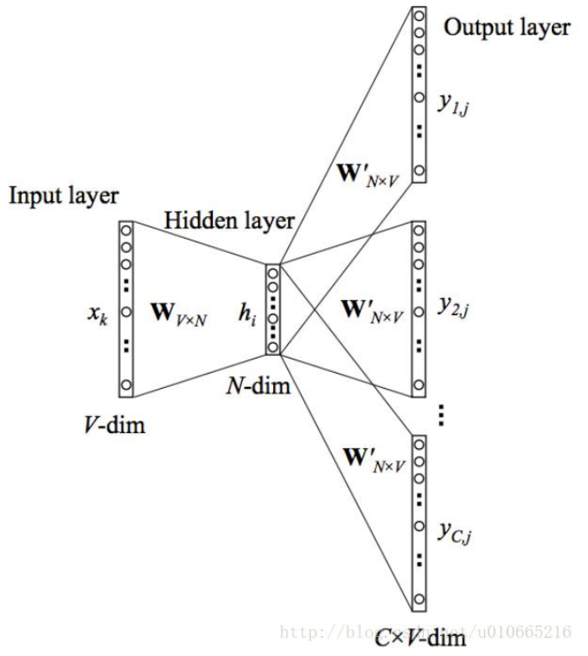
Ways of Embedding - Word2Vec(Skip-gram)
Very similar to CBOW, but opposite it.
All the output share the same weight W’.

Slide 52
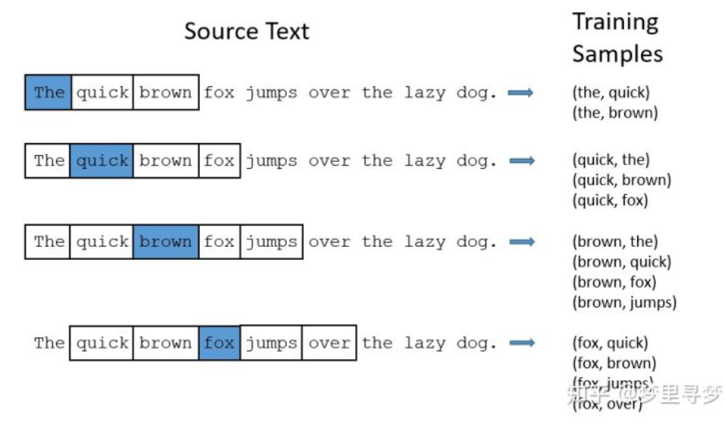
Ways of Embedding - Word2Vec(Skip-gram)
Training data example:

Slide 53
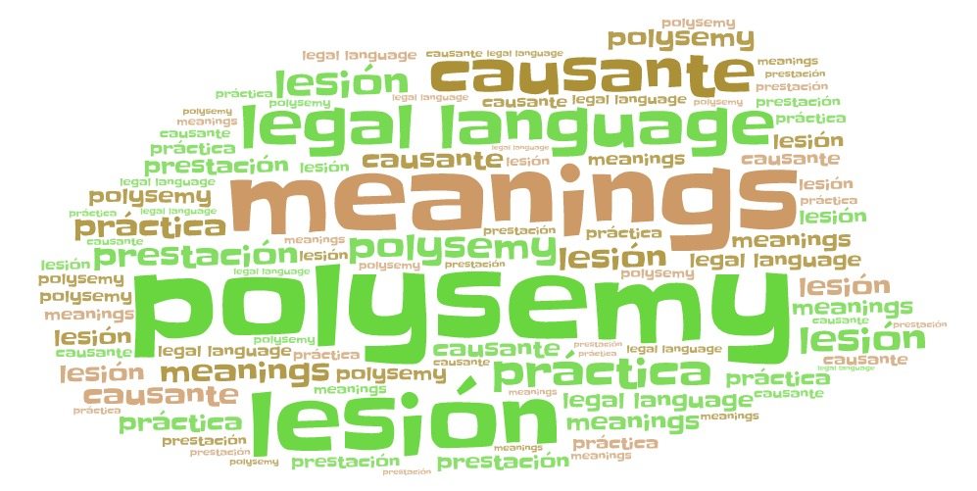
Ways of Embedding - Word2Vec
But actually it can’t solve the polysemy word issue.
Why…?
Notes:
polysemy word synonyms
We know that no matter using CBOW or Skip-gram , they all use previous words and next words to do the training.
So there would be more semantic information in it.
And it can solve the synonyms issue better.

Slide 54
Hands-on!!

Slide 55
We need a Faster Way!

Slide 56
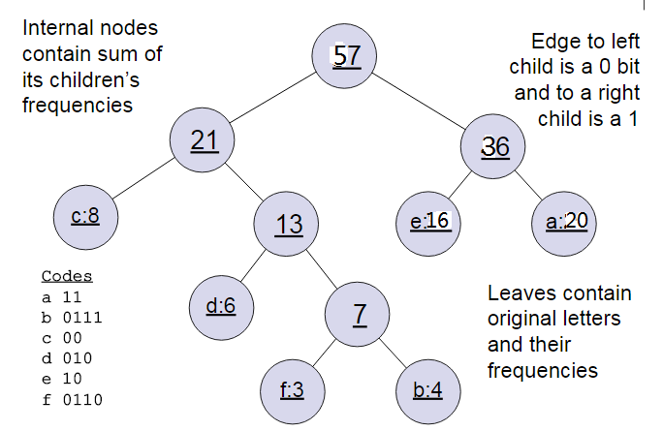
Ways of Embedding - Word2Vec(Hierarchical Softmax)
Huffman Tree
Notes:
In word2vec , 2 rules, left is 0, right is 1, left side weight >=right side weight.

Slide 57
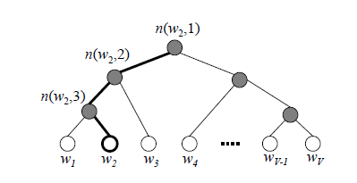
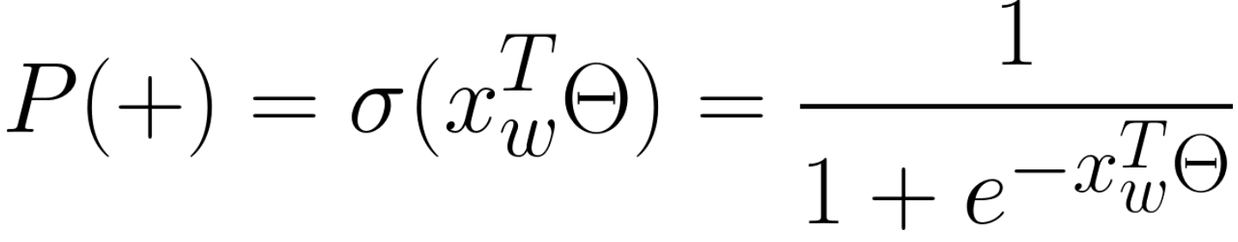
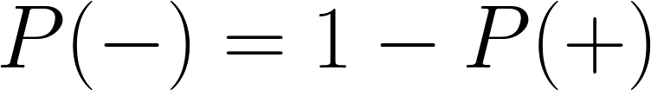
Ways of Embedding - Word2Vec(Hierarchical Softmax)
We need W2.
Positive:
Negative:
Notes:
W is the word, if we want to find the W2, we can follow the tree structure.
The leaf points are the vocabulary size.
This method is that step by step , follow the tree structure, so we call it Hierarchical Softmax.
In W2V, they use Binary logistic regression , left side is negative, code 1, and right side is positive, code 0.
Faster, V==>log2V, higher weight word would have shorter root to be found.(Use frequency to build the tree)
And we can use sigmoid function to do it. Theta is trainable.

Slide 58
Ways of Embedding - Word2Vec(Negative Sampling)
In Huffman tree, if the word is very rare, and we need to find it…..
Tooo complicated………. Huge Tree...
Is there any easier way…?

Slide 59
Ways of Embedding - Word2Vec(Negative Sampling)
In negative sampling, we will sample some negative central words for training.
1.No Huffman tree here.
2.Still Binary logistic regression.
Notes:
Positive central word w0, negative central word wi, i=1,2,3,4….

Slide 60
Ways of Embedding - Word2Vec(Negative Sampling)
Positive:
Negative:
Notes:
W0 is positive example.

Slide 61
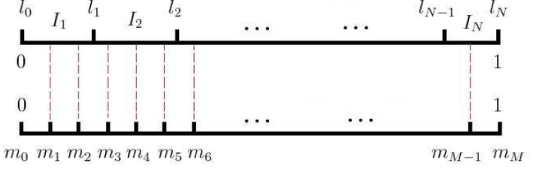
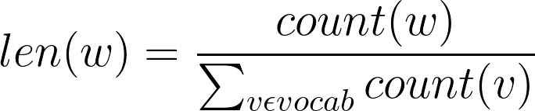
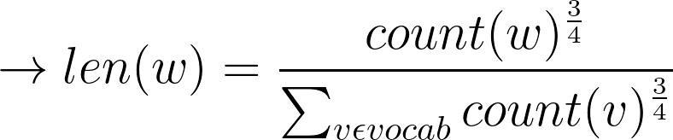
Ways of Embedding - Word2Vec(Negative Sampling)
How to Sampling?
Notes:
We calculate all the words frequency(V), and we give a line that length is 1, we cut the line into M size(M>>V), so we can make sure every piece of the line would match a word. High frequency word would have longer part in the line.

Slide 62
Hands-on!!
Again

Slide 63
Ways of Embedding - Word2Vec(Gensim)
https://blog.csdn.net/qq_24852439/article/details/85302172
Notes:
sg ({0, 1}, optional) – Training algorithm: 1 for skip-gram; otherwise CBOW.
hs ({0, 1}, optional) – If 1, hierarchical softmax will be used for model training. If 0, and negative is non-zero, negative sampling will be used.
negative (int, optional) – If > 0, negative sampling will be used, the int for negative specifies how many “noise words” should be drawn (usually between 5-20). If set to 0, no negative sampling is used.
ns_exponent (float, optional) – The exponent used to shape the negative sampling distribution. A value of 1.0 samples exactly in proportion to the frequencies, 0.0 samples all words equally, while a negative value samples low-frequency words more than high-frequency words. The popular default value of 0.75 was chosen by the original Word2Vec paper. More recently, in https://arxiv.org/abs/1804.04212, Caselles-Dupré, Lesaint, & Royo-Letelier suggest that other values may perform better for recommendation applications.

Slide 64
Ways of Embedding - Word2Vec
So… after trying, what is the advantage of this way?
And what is the disadvantage of this way..?

Slide 65
Ways of Embedding - Word2Vec
Advantage:
1.We have more semantic information.
2.Training faster.
3.Unsupervised training.
4.We can control the dimension.
Disadvantage:
1.Depends on vocabulary size, easy to OOV(out of vocabulary).
2.Can not handle polysemy word.

Slide 66
Ways of Embedding
One-hot encoding
TF-IDF
N-gram
Word2Vec
GloVe

Slide 67
Ways of Embedding - GloVe
You can take it as W2V only using local information, and GloVe want to use global information.
GloVe ⇒ Global Vectors
So how to do it…?
Notes:
When word2vec came to this world, some people think that it’s good at doing synonyms(skip-gram), but it only use the information in
slide-window to train model, and it didn’t use overall statistics.

Slide 68
Ways of Embedding - GloVe
To do it, GloVe use Co-occurrence Probabilities Matrix.
What is Co-occurrence Probabilities Matrix?

Slide 69
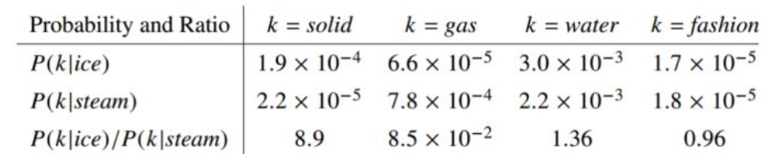
Ways of Embedding - GloVe
Ex:
So we can see that in Co-occurrence Probabilities Matrix, value of Ratio=Pik / Pjk has a rule.
Ratio can represent the relation between words, and GloVe use it.
Ratio of i,j,k | j,k relation | j,k non-relation
i,k relation | Close to 1 | Huge
i,k non-relation | Small | Close to 1
Notes:
Xij in X elements is how many times that word j show in word i context.
Xi = Σk Xik is times of all word show in word i context.
Pij = P(j|i) = Xij / Xi is the probability of word j show in word i context.

Slide 70
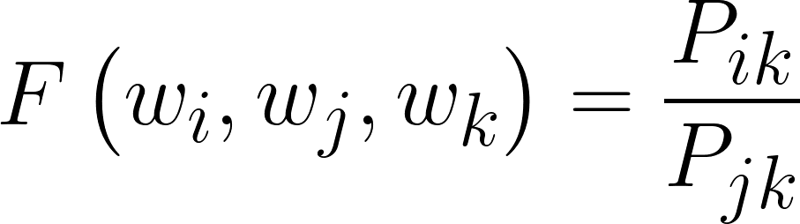
Ways of Embedding - GloVe
Our target is to get the word vector.
So we can say that in word vector , it include the information of Co-occurrence Probabilities.
Notes:
If we have word i,j,k vector, GloVe think that these three vectors go through a “function” will have same rule with Ratio= Pik / Pjk.

Slide 71
Ways of Embedding - GloVe
What’s the difference between W2V and GloVe...?
Both W2V and GloVe are using “co-occurrence” information.
It mean they all use the frequency of words occurrence at same time.
But…
GloVe is count-based model
W2V is predictive model
So what’s predictive model? What is count-based model?

Slide 72
Ways of Embedding - GloVe
Predictive model(W2V):
Using the context to predict the center word, or using the center word to predict context.
Count-based model(GloVe):
Reduce the dimension of co-occurrence matrix.
Notes:
GloVe:
The co-occurrence matrix is calculation the frequency of word occur in context.
Context is multi-words combination so the dimension would be large. So we want to reduce the dimension of context to represent the word vector.(reconstruction loss)

Slide 73
Ways of Embedding - GloVe
Which is better?
The performance is not big different.
But, for speed in large training dataset, GloVe is better.
(GloVe is much easier to be parallelization)

Slide 74
Hands-on!!

Slide 75
Q&A

